Slide 1

TEAM 2
Bay Area Housing Prices
Data Visualization Project

Slide 2

TEAM Members
Alena Dudko
Alper Rasim GUZEL
Patrick McKinney
Rashim Jain

Slide 3

Process and Methodology
Data collection
Median house pricing per SQFT (source: Zillow)
Current forecast for increase in pricing per SQFT (source: Zillow)
Median rental pricing for all homes (source: Zillow)
Total housing units (source: Department of Finance, State of California)
Selected demographics data including:
Population (source: Department of Finance, State of California)
Crime rate (source: Wikipedia)
Data filter and cleaning
Selecting major cities for the project
Cleaning the data as some data for the selected cities was not available for certain time periods
Arranging the data in a format for creating a database

Slide 4
Process and Methodology
Database
Combined all data in a single CSV
Created the SQLITE database
Charts using dygraphs and ZingChart JS libraries
Created the Map of Cities with selected demographics as pop-ups using the Leaflet JavaScript library
Created a Interactive Dashboard using HTML, CSS, JavaScript, Flask

Slide 5
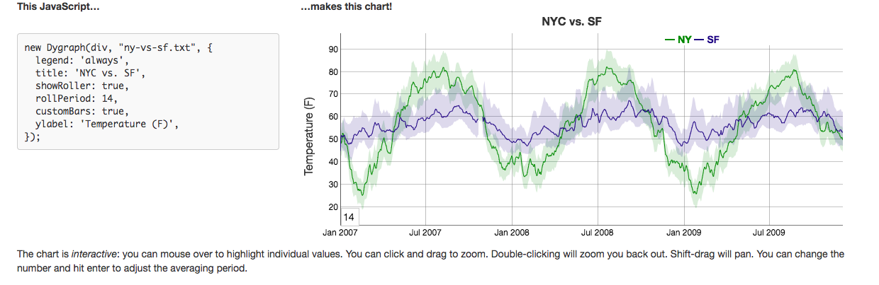
Dygraphs
dygraphs is a fast, flexible open source JavaScript charting library.
http://dygraphs.com/download.html

Slide 6

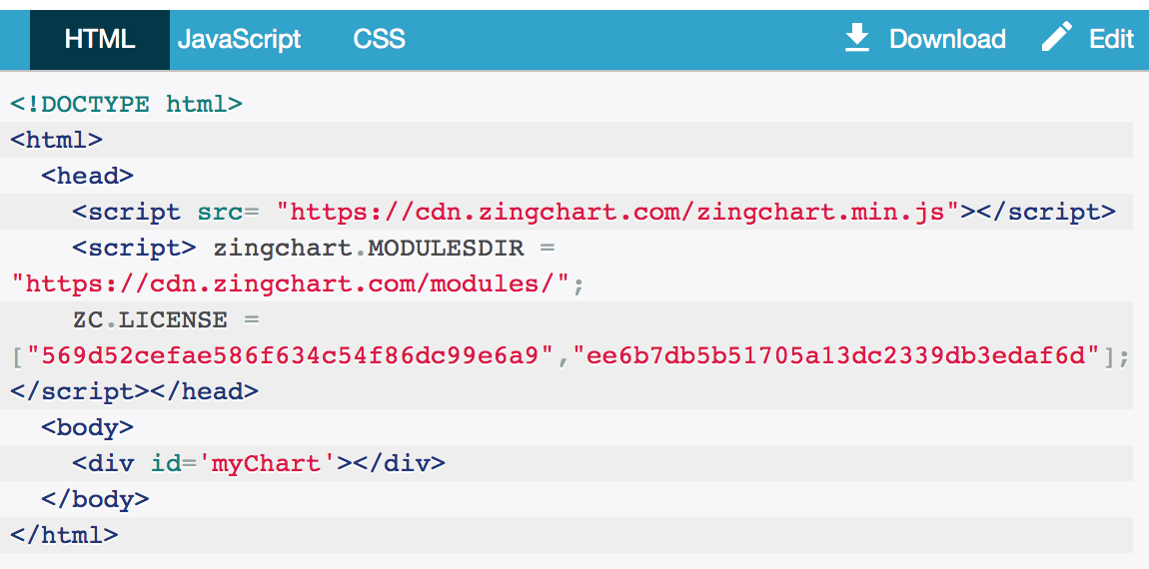
ZingChart
https://www.zingchart.com
https://github.com/zingchart/ZingChart

Slide 7
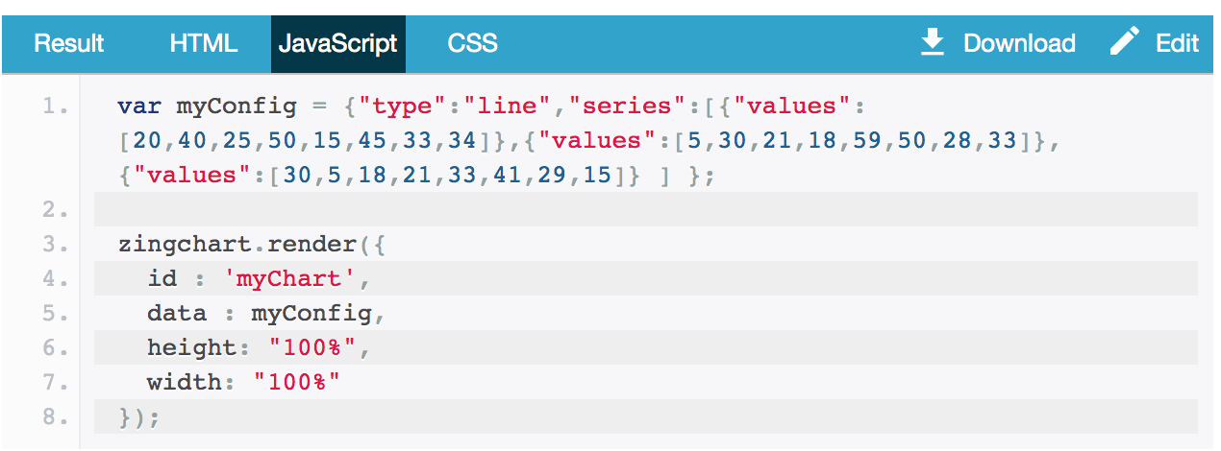
ZingChart
https://www.zingchart.com
https://github.com/zingchart/ZingChart

